Slide 1
Creating an All of Us Account
Pre-requisite for the All of Us researcher workbench training
*Email Max Wegener at maximilian.wegener@yale.edu for any questions or issues

Slide 2
Objectives
Create an All of Us user account
Once completed, you will have:
An All of Us account
Access to the All of Us Workbench
A workspace where you will access and analyze All of Us data
Please Note: This is a mandatory prerequisite to be completed prior to All of Us trainings

Slide 3
Part 1: Creating an account (15 to 20 minutes)

Slide 4
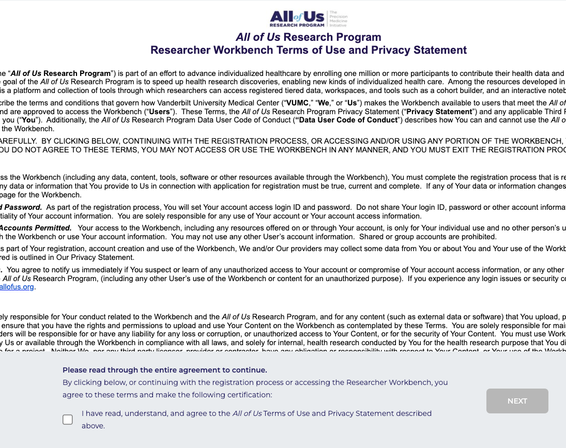
To start…
Navigate to the All of Us here *Chrome is recommended
Choose “Create Account”
Read the Terms of Use and Privacy Statement and check the box “I have read, understand…” to continue

Slide 5
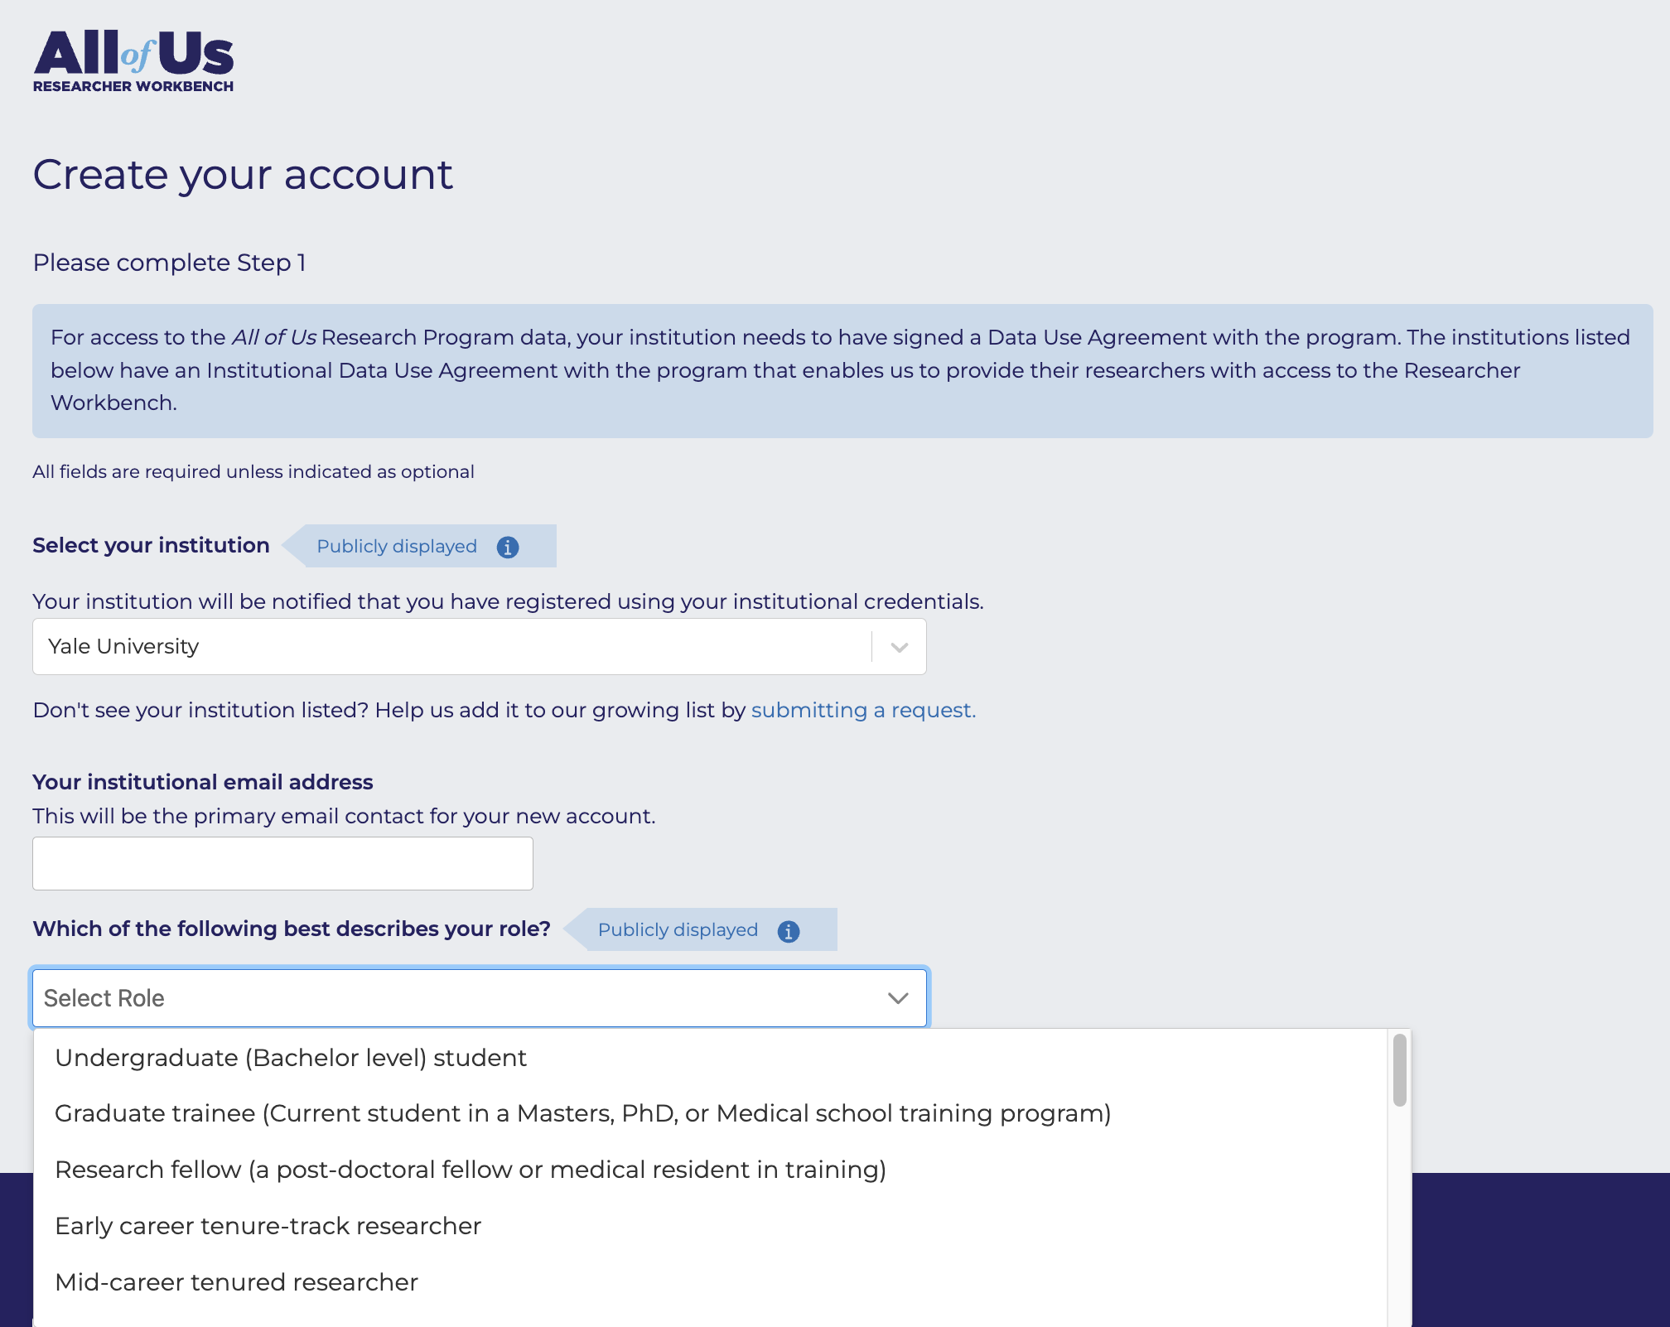
Step 1
Select institution [Yale University]
Add your yale.edu email address
Choose your role
Click “Next”

Slide 6
Step 2
Create your username (this will setup a Google account ending in @researchallofus.org)
Add your personal information
Add your institutional address (use the Yale Staff directory to find your address)
Write a brief statement about your background, experience, and research interests IMPORTANT – This will be publicly available
Select how you heard about All of Us
Add your demographic information
Click “Submit”

Slide 7
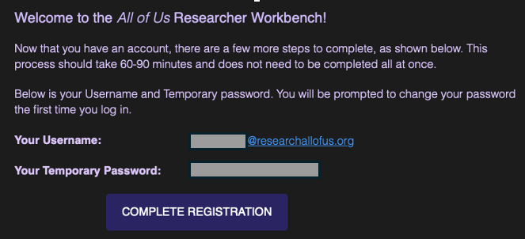
Confirmation
After you click submit, you will see a confirmation page stating your account was created
Check your Yale address for a welcome email containing your temporary password and a link to complete your registration from
IMPORTANT: Click the “Complete Registration” button to ensure your account is successfully authenticated

Slide 8

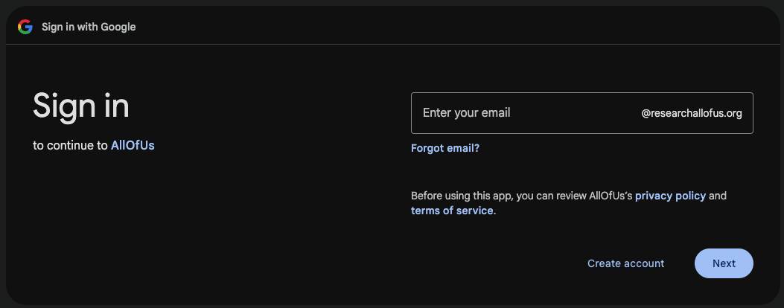
Sign in to Your Workbench
After clicking “Complete Registration” you will be sent to the All of Us Researcher Workbench - click “Sign In”
Input your All of Us username (see welcome email)
Input your All of Us temporary password (see welcome email)

Slide 9
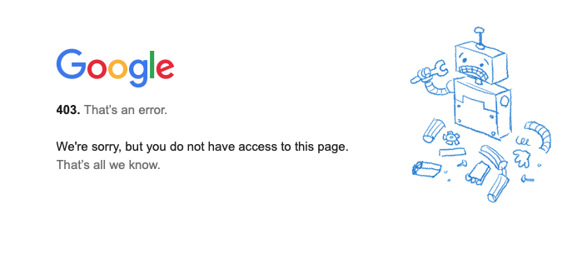
Change Your Password
Once logged in, you will be prompted to change your password
Once changed, click “Enter”
After you click “Enter” you may run into an error page
If so, use this link to continue to the All of Us registration page

Slide 10
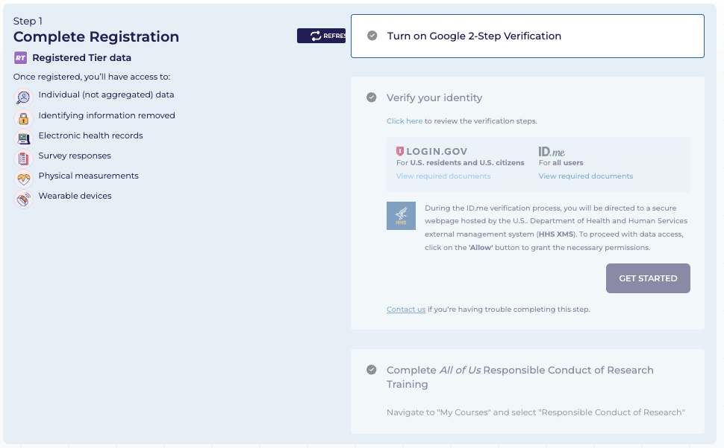
Part 2: Data access registration (90 to 120 minutes)

Slide 11
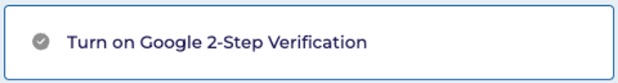
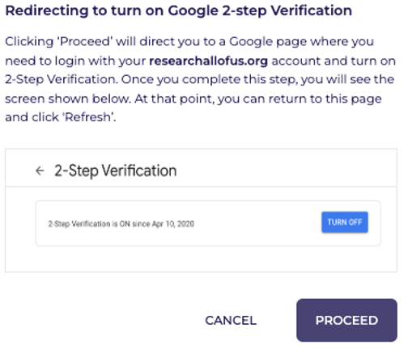
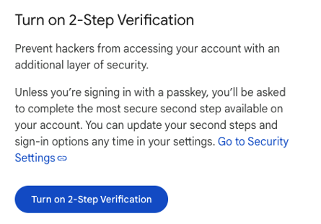
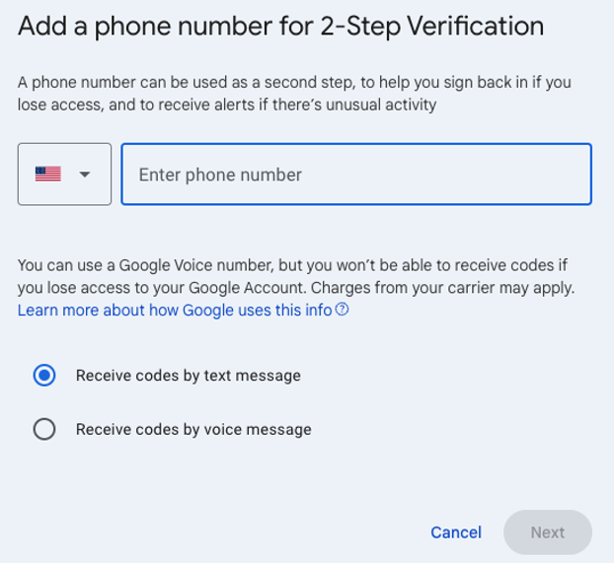
Google 2-Step Verification
Click the gray check mark
Click “Proceed”
Click “Turn on 2-Step Verification”
Add your mobile number and click “Next”
Go back to the registration page and refresh it – the gray check mark should be green now

Slide 12
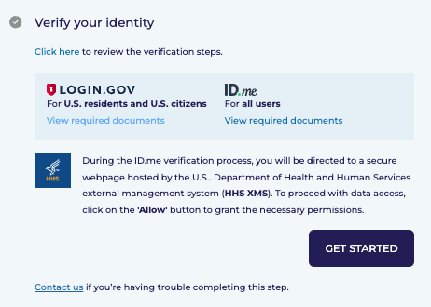
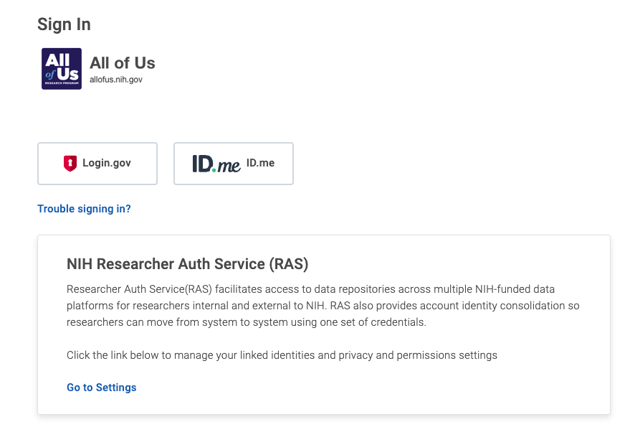
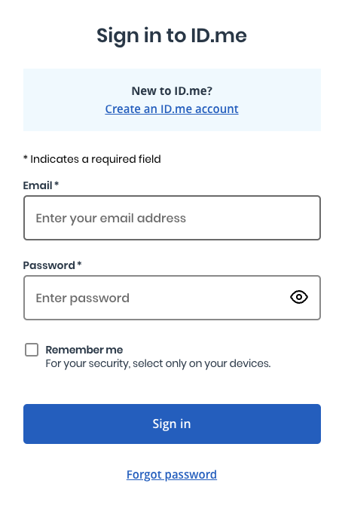
Verify Your Identity
Click “Get Started” on the registration page
If you are a new user, click “ID.me” - otherwise select an option you’ve used in the past
Select “Create an ID.me account” – You can use any email you prefer [suggest using Yale.edu]

Slide 13
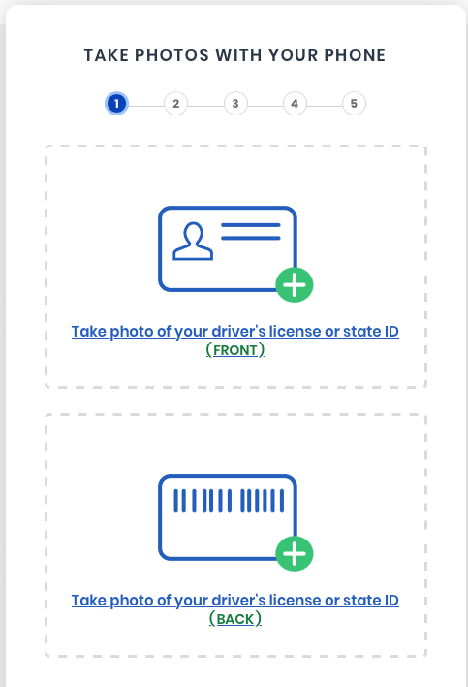
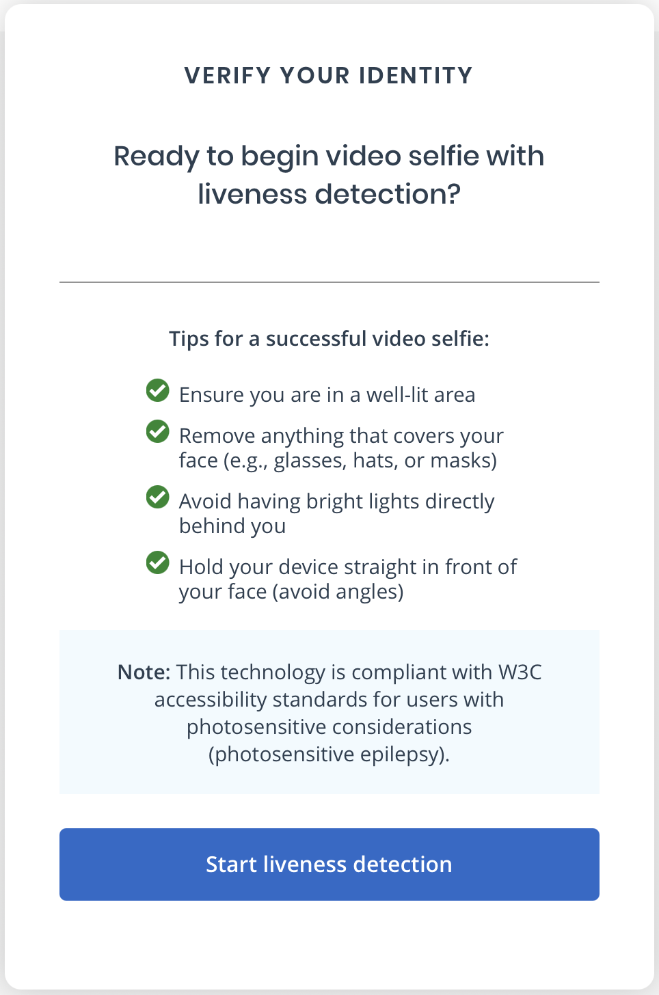
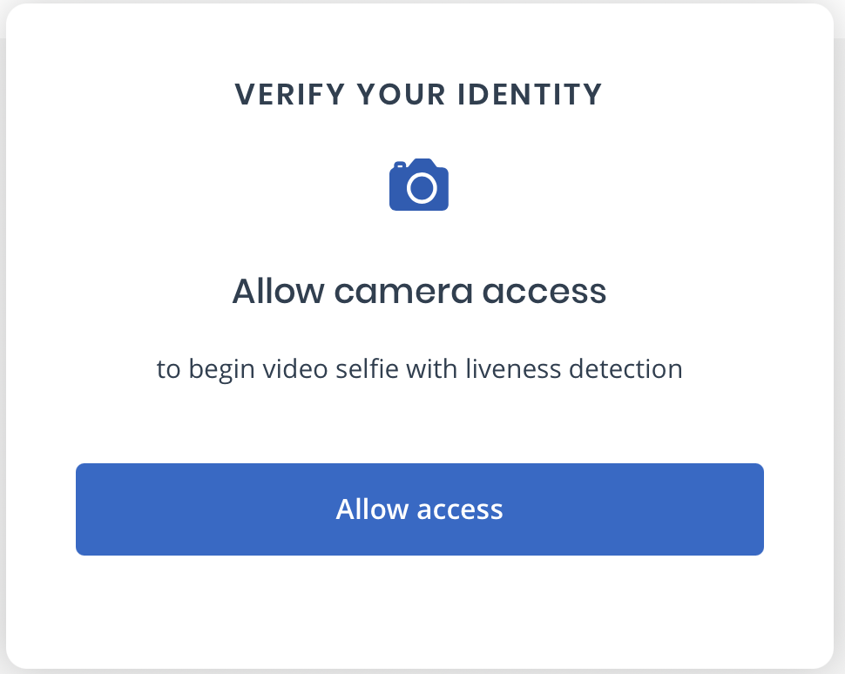
Verify Your Identity, continued
Take front and back photos of your driver’s license or state ID, or upload exiting photos
After you submit your photos, you will need to take your Video Selfie
Allow ID.me access to your camera
Review “Tips for a successful video selfie” and click “Start liveness detection”

Slide 14
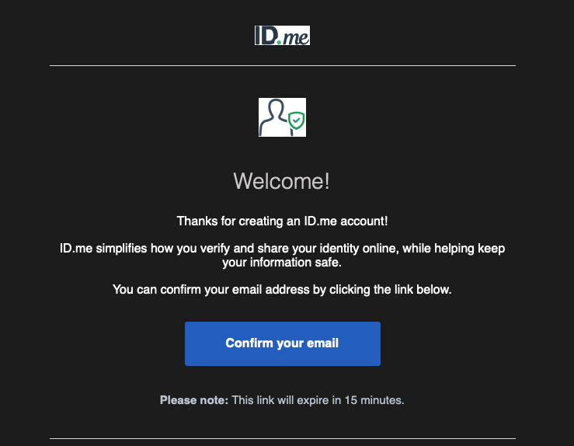
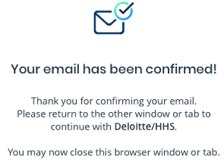
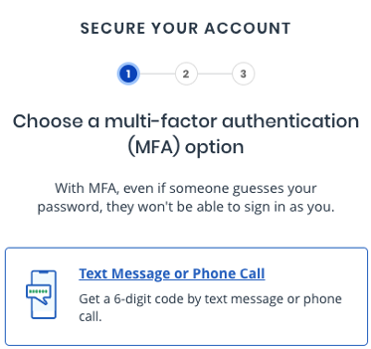
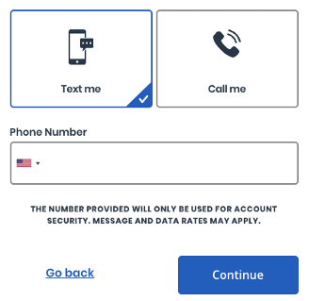
Verify Your Identity, continued
After you create an ID.me account, you will receive an email asking you to confirm your email
Once clicked, a window should appear stating your email has been confirmed
The ID.me page should refresh, and multi-factor authentication options should appear – choose “Text message or phone call”
Select “Text me” – enter your mobile number, and click “Continue”

Slide 15
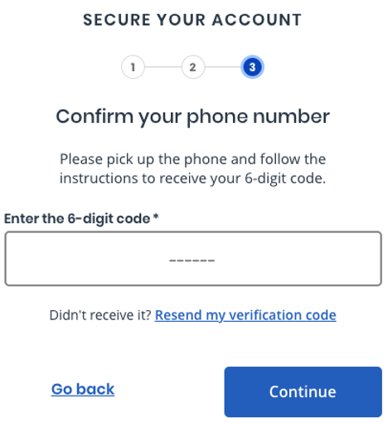
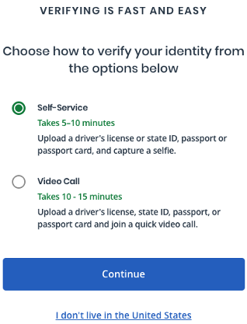
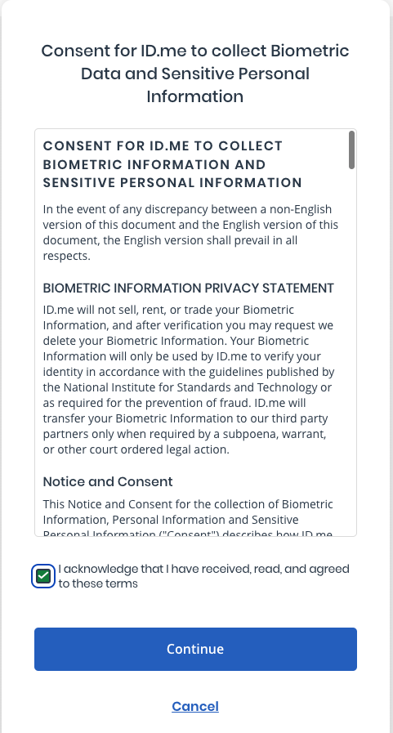
Verify Your Identity, continued
Enter the 6-digit code into the box and click “Continue”
Once the code has been confirmed, two verify options will appear – choose “Self-Service”
Give ID.me consent to collect your data *Prepare for the next steps by having your driver’s license or state ID handy

Slide 16
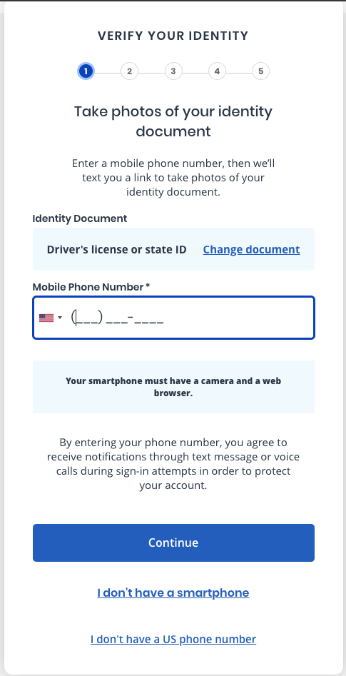
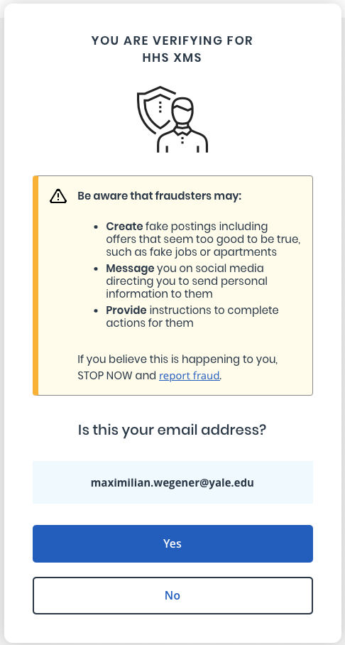
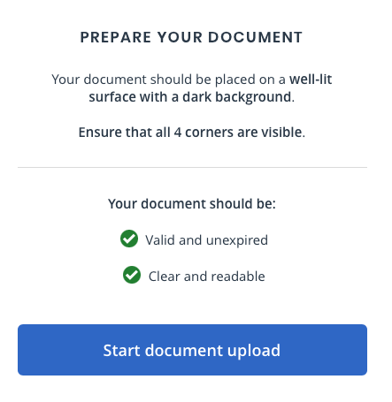
Verify Your Identity, continued
Enter your phone number and click “Continue”, then verify your email address in the next window
Select “Start document upload” in the new window that pops up

Slide 17
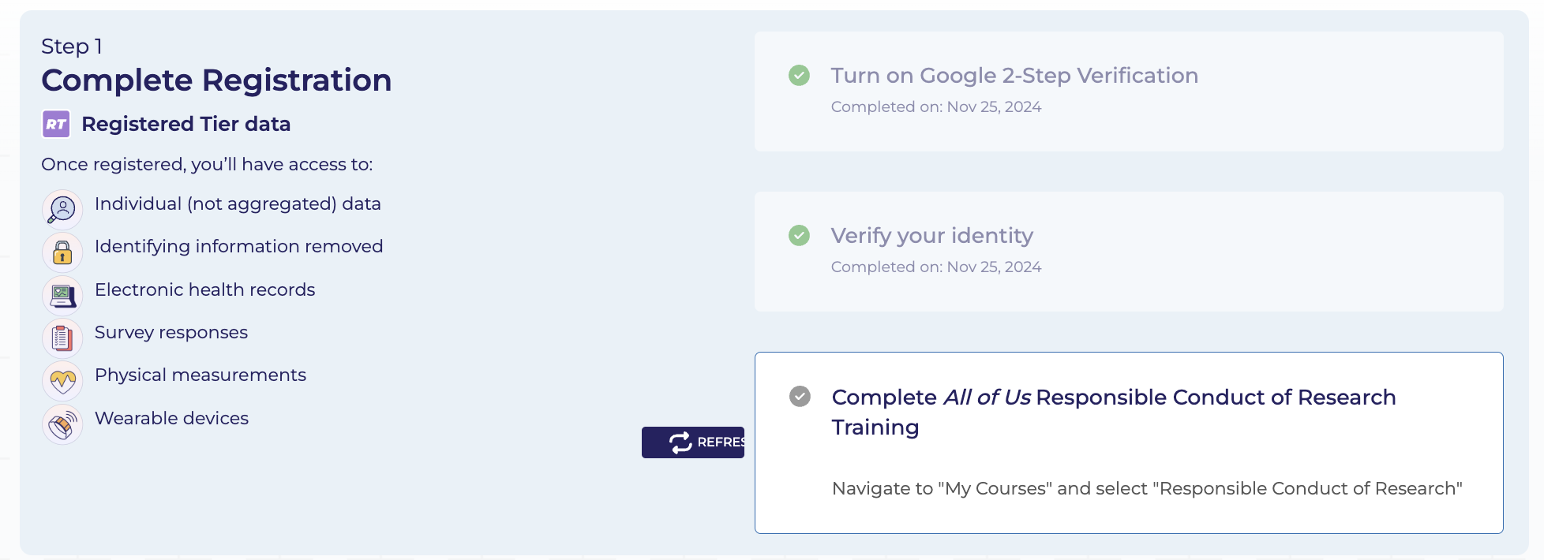
Verify Your Identity, continued
Once your face is scanned, a window will appear saying your image has been submitted
You will be asked to return to the registration page
Verification should take about 10 minutes (refresh the page and the check mark next to “Verify your identity” should now be green)

Slide 18
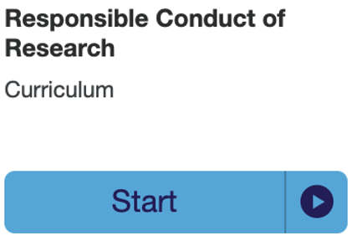

Complete All of Us Responsible Conduct of Research Training
Click the gray check mark next to “Complete All of Us Responsible Conduct of Research Training”
Click “Start” and then “Enroll”
The course should begin. It takes around 20-30 minute to complete

Slide 19
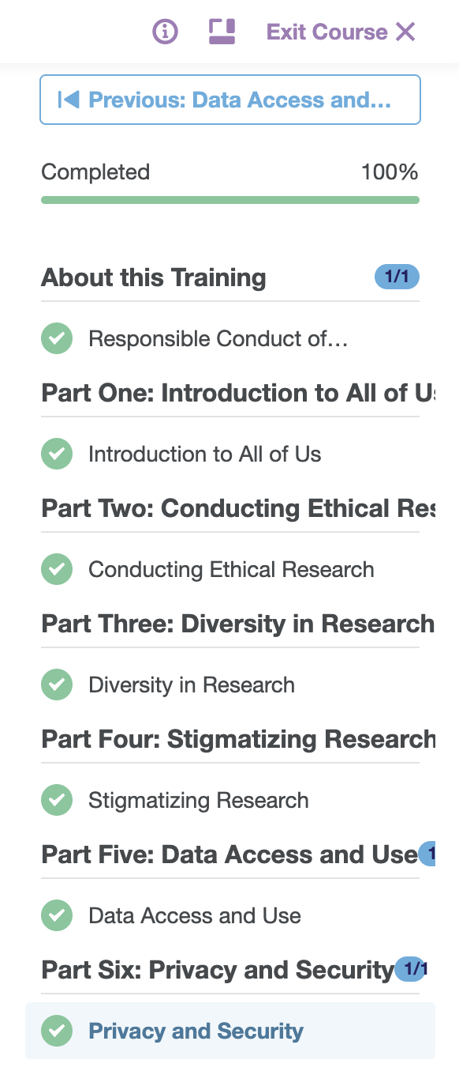
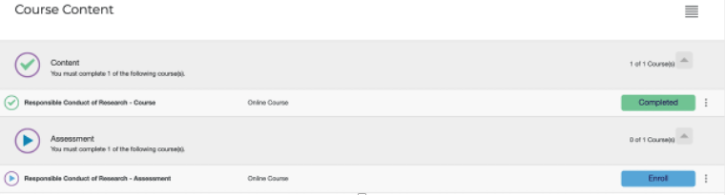
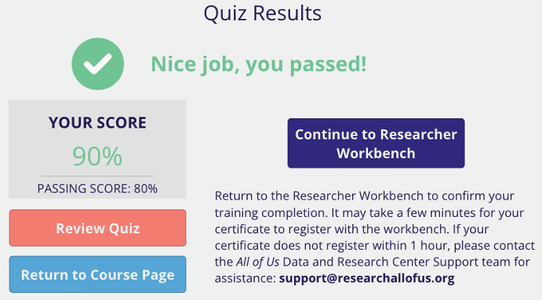
Complete All of Us Responsible Conduct of Research Training, continued
Once you have completed all the training modules, click “Exit Course” on the top right corner
Click “Enroll” for the assessment
Start the assessment *It says there is a 24-hour waiting period after each failure but its not true, you can continue to take the assessment until you pass
Once you pass the assessment, click “Continue to Researcher Workbench”

Slide 20
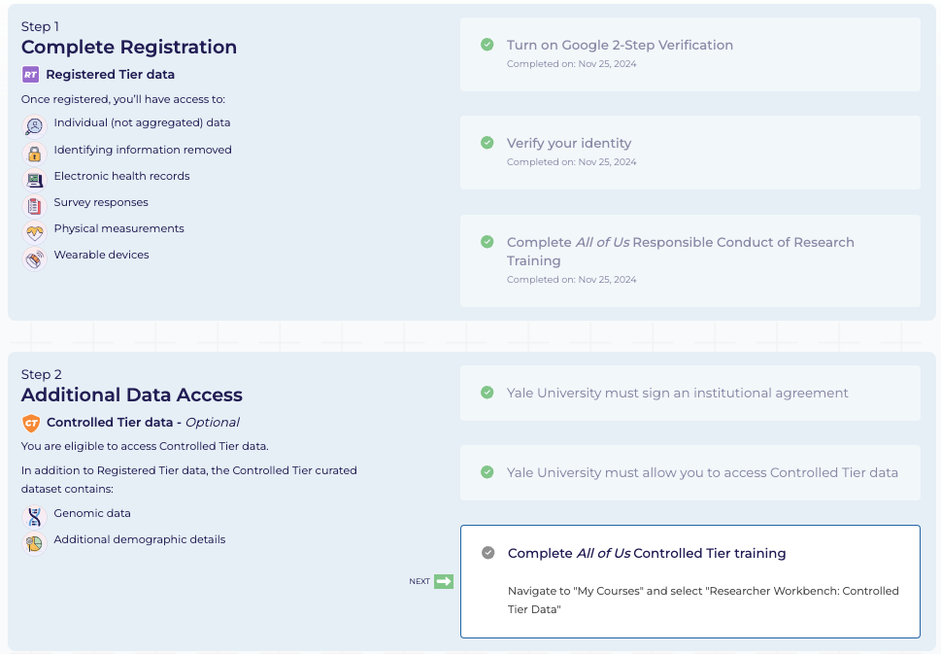
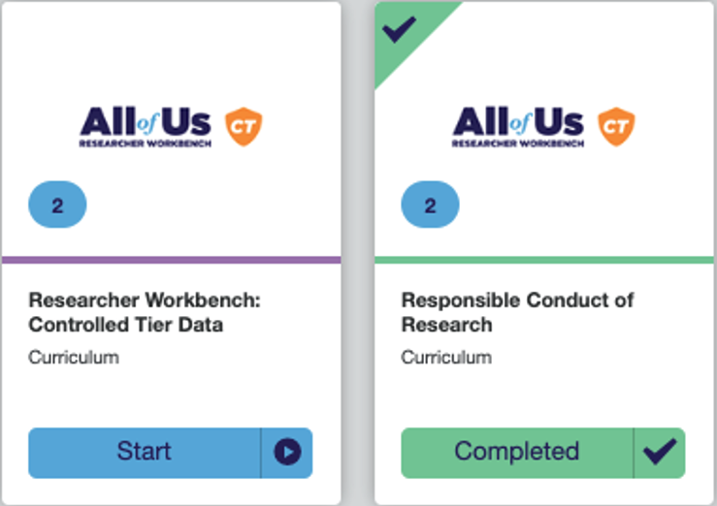
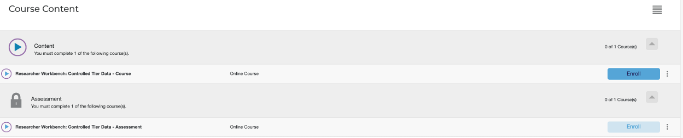
Complete All of Us Responsible Conduct of Research Training, continued
You will notice that all check marks are green in steps 1 and 2 except one – “All of Us Controlled Tier Training” *Because Yale University has a signed Institutional Agreement with All of US, you will have Controlled Tier Data access once some additional training is completed
Click the gray check mark next to “Complete All of Us Controlled Tier Training”
Click “Start”, then click “Enroll” to begin *The course takes around 20-30 minute to complete

Slide 21
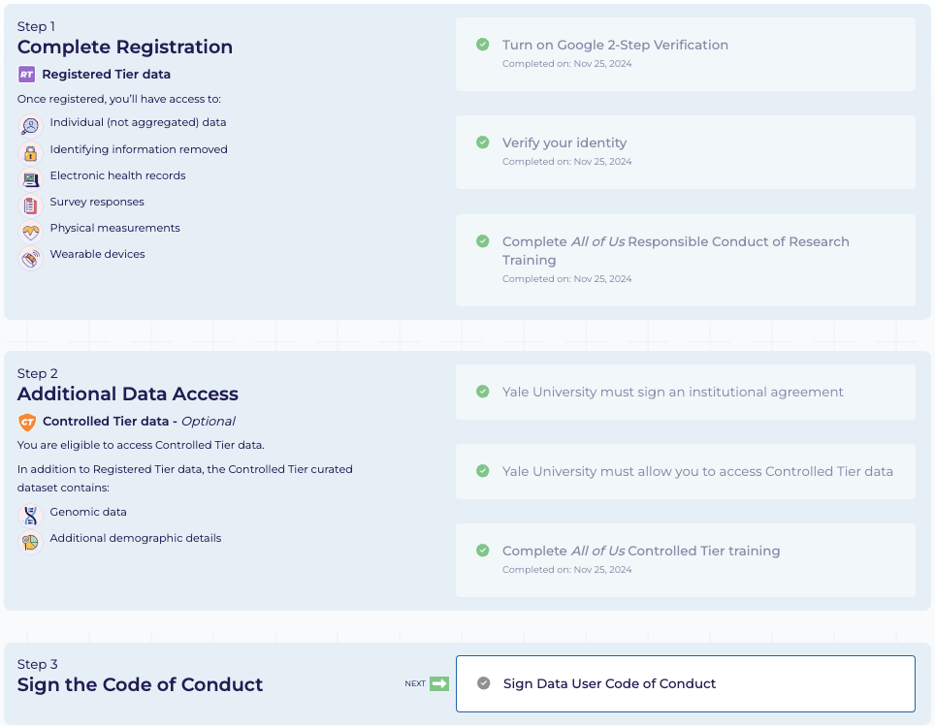
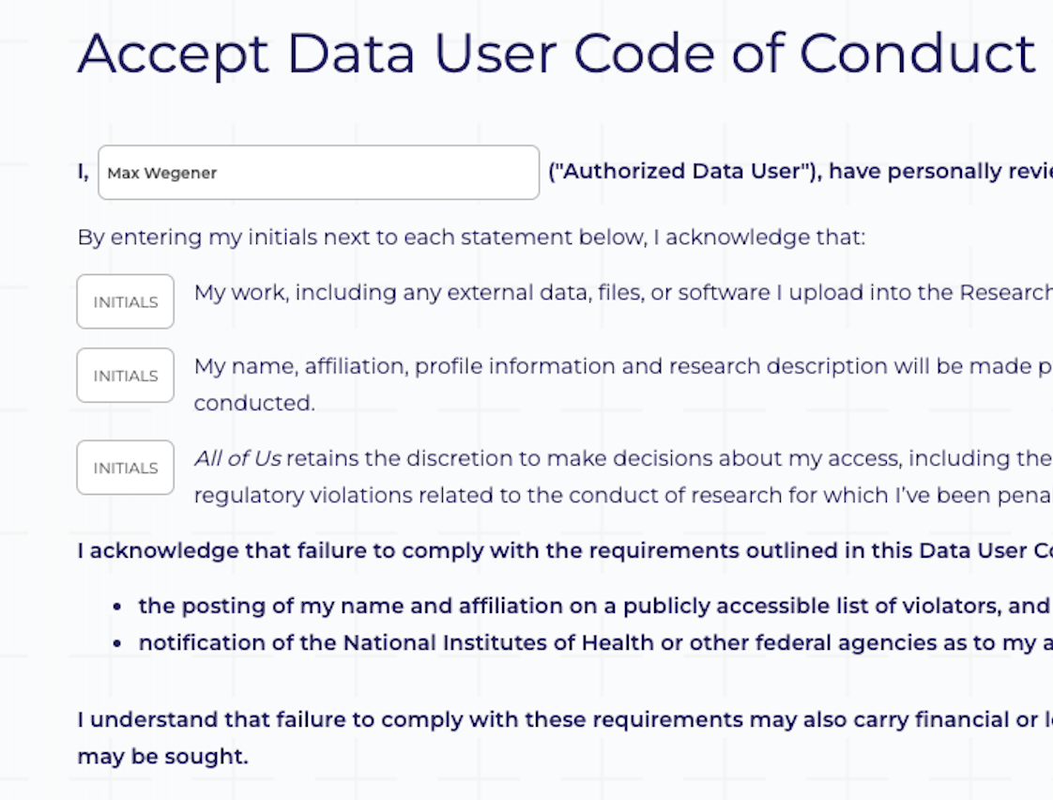
Sign the Code of Conduct
The final step is to “Sign Data User Code of Conduct” by clicking the gray check mark
Read the Code of Conduct. Scroll down and click “Proceed” in the bottom left corner
On the next page, “Accept Data User Code of Conduct”, ensure your information is correct and enter your initials in the boxes labeled “Initials”, then click “Accept” in the lower right corner

Slide 22
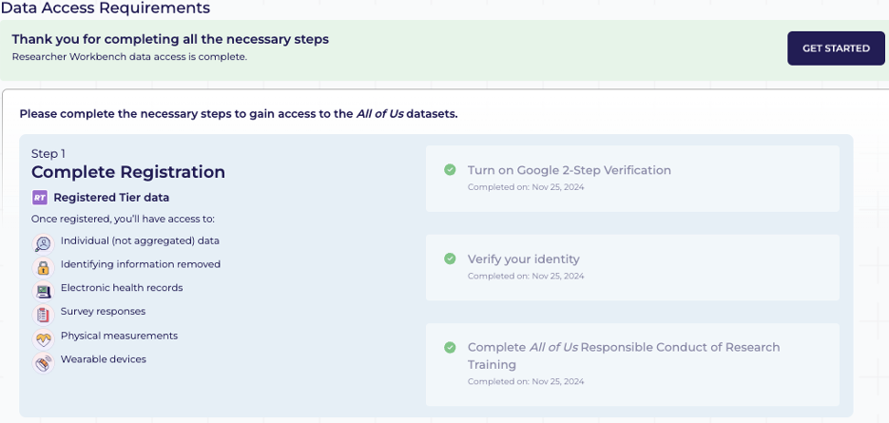

Sign the Code of Conduct, continued
You should automatically redirect to the Registration page where all check marks are now green
A new button should appear in the top right labeled, “Get Started” – click this to access the All of Us Workbench
The next step is to create a workspace

Slide 23
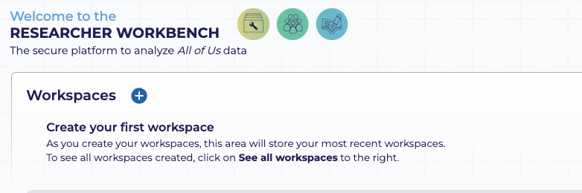
Part 3: Create an All of Us Workspace (10-15 minutes)
Please Note: This workspace is for training purposes, more details and information will be needed for future research projects

Slide 24
Create a Workspace
To begin, click the plus sign next to “Workspaces”
Create a workspace name with the following conventions “LastName_CWML_training”
Change Data access tier to “Controlled Tier” – Keep Dataset Version as the default “…Dataset v7”

Slide 25
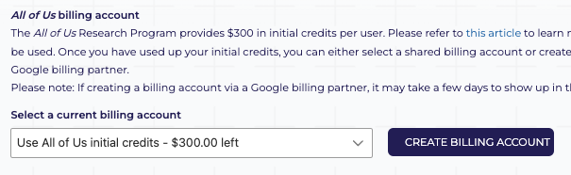
All of Us Billing
All of Us provides an initial $300 credit – select this option. DO NOT create a billing account at this time (training on this will be provided in the future) – refer to this article for more information on the credit

Slide 26
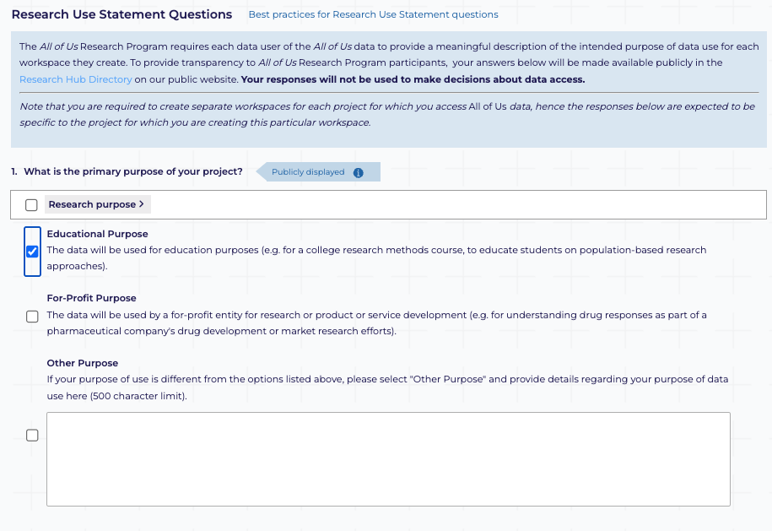
ç
Research Use Statement Questions
Since you will be using this workspace for training purposes, select “Educational Purposes” for the primary purpose of your project

Slide 27
Research Use Statement Questions, continued
For questions 2.1 - 2.3, please copy/paste the responses in blue into the workspace form
What are the specific scientific question(s) you intend to study, and why is the question important?
This workspace is dedicated solely to educational purposes. Its purpose is for academic instruction on how to utilize AoU datasets including: accessing, manipulating, and analyzing data.
What are the scientific approaches you plan to use for your study?
This workspace is dedicated solely to educational purposes. Its purpose is for academic instruction on how to utilize AoU datasets including: accessing, manipulating, and analyzing data.
What are the anticipated findings from the study? How would your findings contribute to the body of scientific knowledge in the field?
While no specific findings are anticipated from this educational endeavor, it is designed to equip researchers with the tools and knowledge necessary to explore and investigate topics related to the available AoU data.

Slide 28
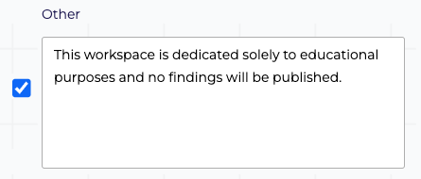
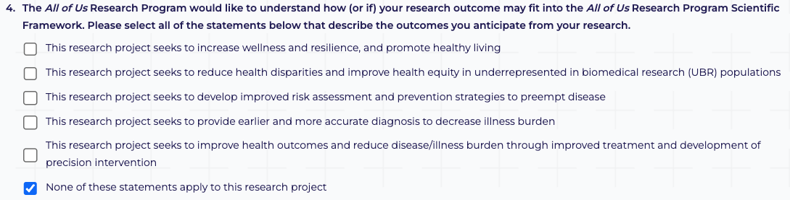
Research Use Statement Questions, continued
For Question 3, choose “Other” and enter, “This workspace is dedicated solely to educational purposes and no findings will be published”, in the text box.
For Question 4, choose “None of these statements apply to this research project”

Slide 29
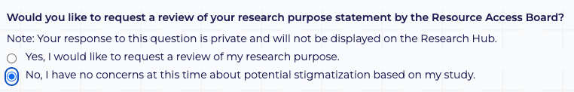
Research Use Statement Questions, continued
For Question 5, select “No, my study will not center on underrepresented populations”
For Question 6, choose “No, I have no concerns at this time about potential stigmatization based on my study.”

Slide 30
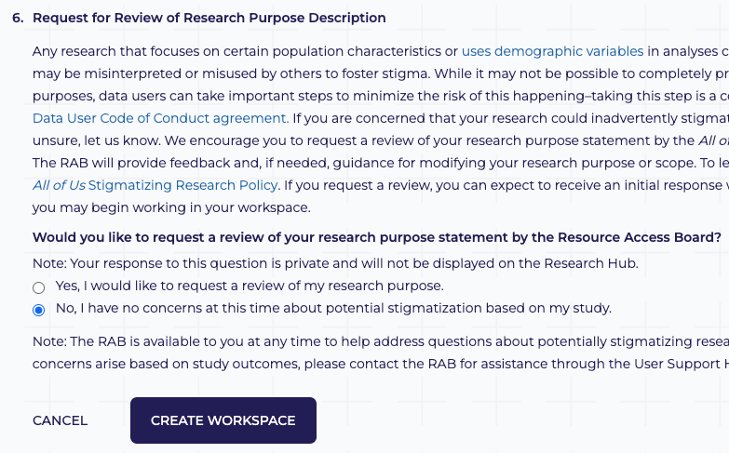
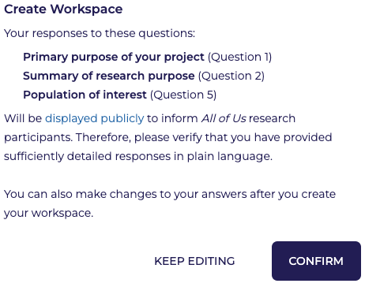
Research Use Statement Questions, continued
Once the form is complete, the “Create Workspace” button on the bottom of the screen will turn blue – click the button
Click “Confirm” in the next window

Slide 31
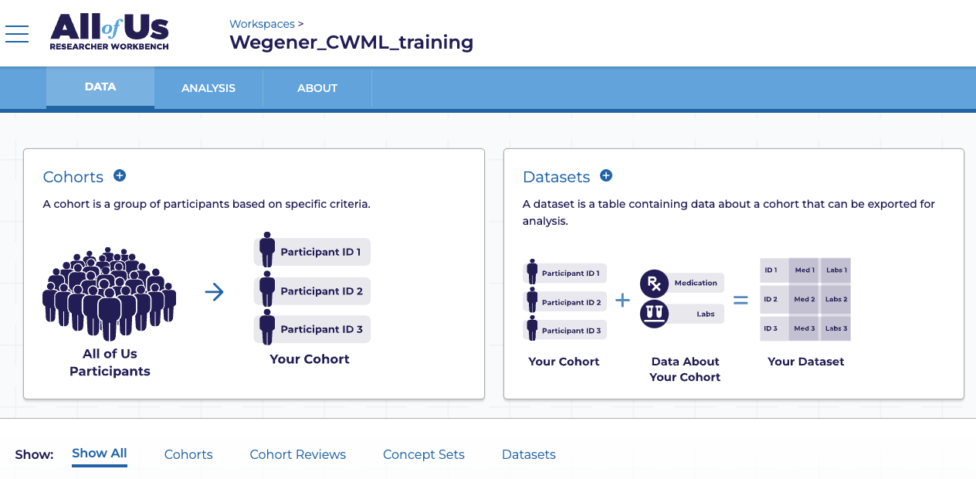

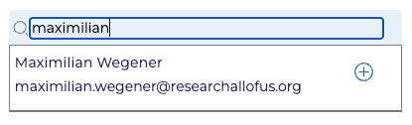
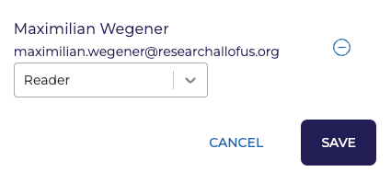
Your Workspace
Now you should be in your newly created workspace
Navigate to the “About” section
Choose “Share” and begin typing my name in the “Find collaborators” search field
Click the plus button and click “Save” to ensure your workspace will be shared with me *Sharing your workspace with me will be proof that you’ve met the prerequisites for All of Us training

Slide 32
If you have questions or run into issues, please email Max Wegener at Maximilian.Wegener@yale.edu

